Slide 1
CS101
Computer Software

Slide 2
Software
Software is a set of instructions for the computer to follow to accomplish a task.
Two main types of software are…
1) Operating System
2) Applications

Slide 3
Applications
Applications (also called Programs) = Instructions for the computer on how to do certain functions under the control of the operating system
Examples Of Applications:
Firefox
Microsoft Word
Games
Etc.

Slide 4
Operating System
Set of instructions that controls all hardware and software on the computer
Examples:
MacOS
Windows
Linux
Chrome

Slide 5
Why care what operating system runs your computer?

Slide 6
Why care what OS runs your computer?
Everyone else has to go through them to get to you. This gives the OS owner tremendous power.
1) The tale of IBM vs. Microsoft
Triumph of the Nerds
2) The tale of Netscape vs. Microsoft
How to kill competition when you own the OS.

Slide 7
Operating System Current Usage Percentage
Desktop Operating System Market Share Worldwide
Wikipedia Operating System Current Usage

Slide 8
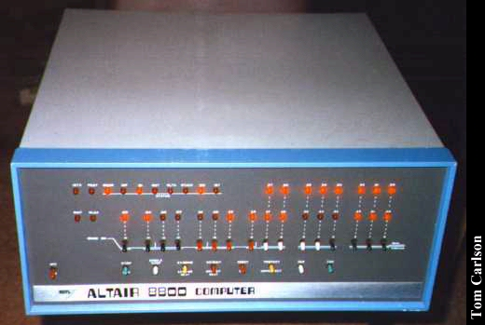
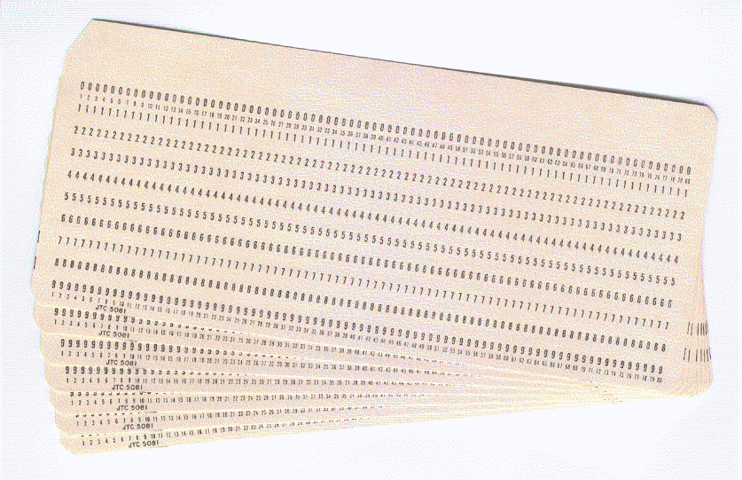
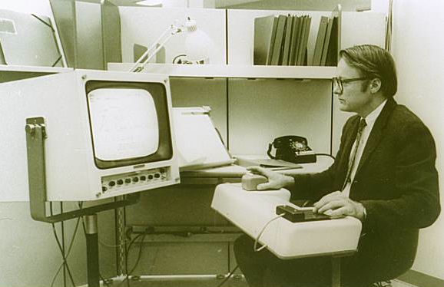
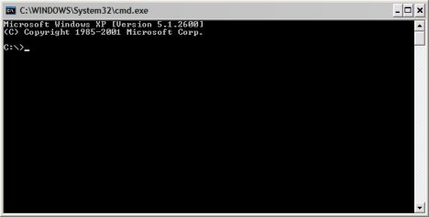
The Tale of Apple vs Microsoft: Evolution of the operating system interface
Douglas Engelbart

Slide 9
What explains the Mac and Windows Stereotypes?
Is it an Open or Closed System?

Slide 10
What is an open or closed system?
Open = No one owns the rights to making a computer with that operating system installed on the computer.
Closed = Someone does own the rights to making a computer with that operating system on the computer.

Slide 11
Windows runs an open system
Open System = No one owns the rights to the hardware configuration that makes up a Windows computer.
Good
Bad

Slide 12
Macintosh OS runs a closed system
Closed system = Apple owns the rights to the hardware configuration of an Apple computer (Macintosh)
Good
Bad

Slide 13
Why is Chrome OS starting to catch on?
Open system:
Cheap
Google makes money on your data

