Slide 1
CS101
How A Computer Works

Slide 2
What we know!
To be a computer it needs to do four things:
1 Input
2 Process
3 Output
4 Store
We might already know a lot about three of these requirements.
The second, process, we might be a little sketchy.

Slide 3
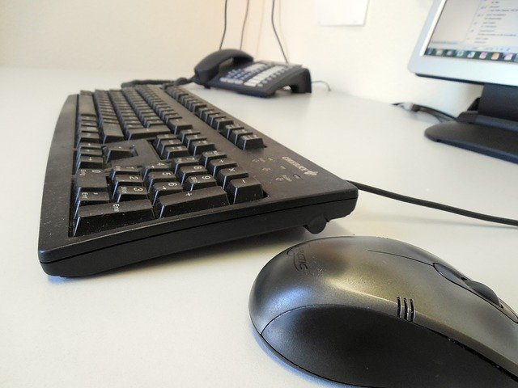
Input Parts
Translate our world into zeros and ones.

Slide 4
Output Parts
Translate zeros and ones into our world.

Slide 5
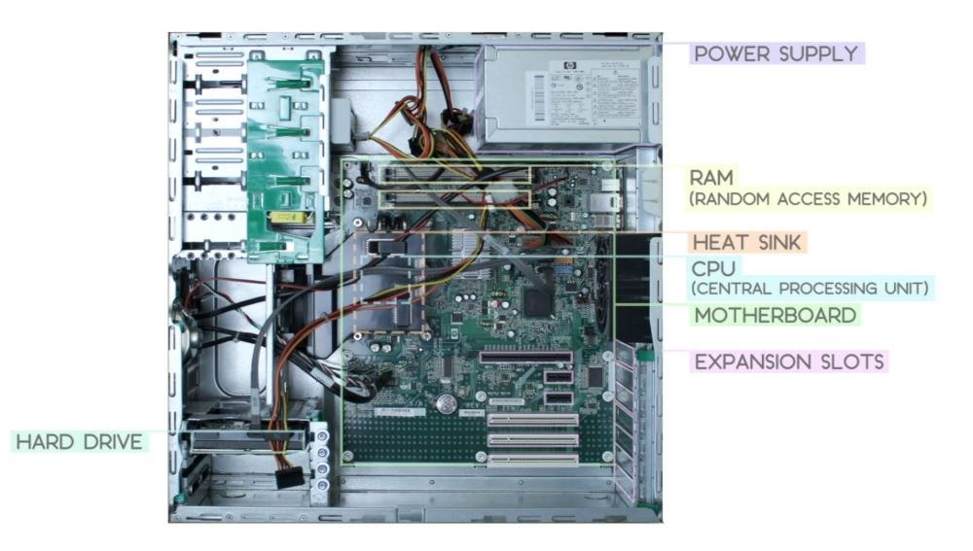
CS101
Parts of a Computer

Slide 6
Storage Parts
Keeps the electronic 0’s and 1’s safe when the power is turned off.

Slide 7
Bits to Bytes
Computers store information in byte size chunks
A zero or a one = bit
8 Bits = 1 Byte
1024 Bytes = Kilobyte
1024 Kilobytes = Megabyte (1,048,576 Bytes)
1024 Megabytes = Gigabyte (1,073,741,824 Bytes)
1024 Gigabytes = Terabyte (1,099,511,627,776 Bytes)
Etc.
Keeps going by a factor of 1024
1024 because computer is a base 2 device

Slide 8
Converting Measurements
To convert a smaller unit to a larger unit divide by 1024 for each level
To convert a larger unit to a smaller unit multiply by 1024 for each level

Slide 9
How big is it?
How do I know how many bytes fit on a disk and how much of the disk is currently being used?
Windows = Right click on the disk icon and select “Properties”
Macintosh = Select Apple menu > About This Mac > Storage
How do I know how many bytes a file is taking up on a disk?
Windows = Right click on the file icon and select “Properties”
Macintosh = Right click on the file icon and select “Get Info”

Slide 10
Hard Drives
Magnetic Drive
SSD
Solid
State
Drive

Slide 11
Process Parts
Everything plugs into the motherboard.
The processor is where 0’s and 1’s change form.
RAM is where 0’s and 1’s hang out waiting to be sent to the processor.
The motherboard and the RAM are the two most important parts in the processing of 0’s and 1’s.

Slide 12
Motherboard

Slide 13
CPU
Central
Processing
Unit

Slide 14
RAM
Random
Access
Memory

Slide 15
Dedicated Graphics

Slide 16
How do the zeros and ones change form in the processor?

Slide 17
Why do we want to know this?
We want to know this because the processor is one of the most important inventions of all time
We want to be amongst the few people in the world to know the basics of this important invention (and it will be on the quiz)

Slide 18
The basic on/off switches of a processor are arranged to form logic gates
In logic gates 0 = false and 1 = true
Another way to think about it is:
Switch off = 0 = false Switch on = 1 = true
Four basic logic gates are:
AND gate
OR gate
XOR gate
Inverter (NOT) gate

Slide 19
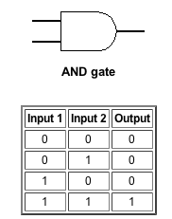
AND Gate Output

Slide 20
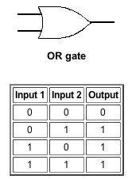
OR Gate Output

Slide 21
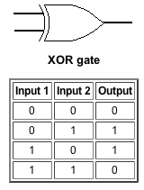
XOR Gate Output

Slide 22
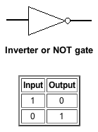
Inverter (NOT) Gate Output

Slide 23
Using logic gates…
… the four basic gates can be combined to make other gates (NAND, NOR, and XNOR).
… zeros and ones can go into the processor and change into different zeros and ones.
… the processor can perform basic arithmetic and logic operations.

Slide 24
Which means…
… everything your computer does (email, instant message, play games, listen to music, play video, word process, etc) must be broken down into basic arithmetic and logic operations which is accomplished by running zeros and ones through the logic gates found in a processor.

Slide 25
How a program runs on a computer
When you double click on a program icon to run a program the programs directions are sent to RAM
As the programs directions are needed they are sent to the processor to be processed
The processor has two main parts:
Control Unit
ALU (Arithmetic Logic Unit)

Slide 26
The Control Unit in the processor is responsible for controlling the program as it runs.
The Arithmetic Logic Unit in the processor is responsible for basic arithmetic and logic operations.

Slide 27
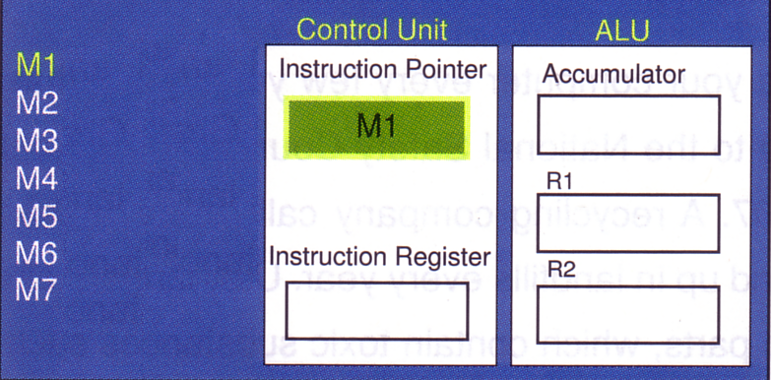
RAM and CPU

Slide 28
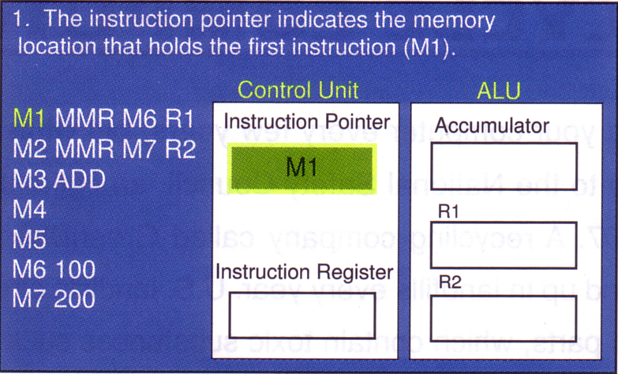
How a program runs on a computer

Slide 29
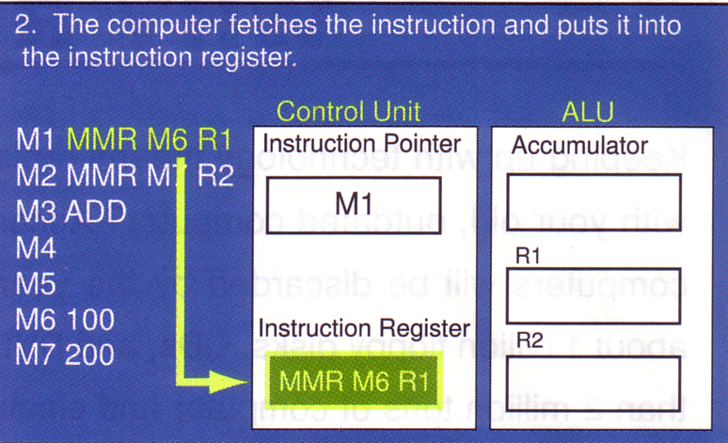

Slide 30
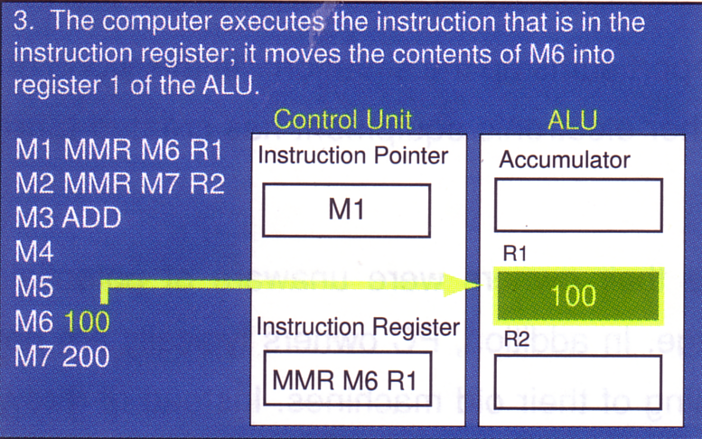

Slide 32
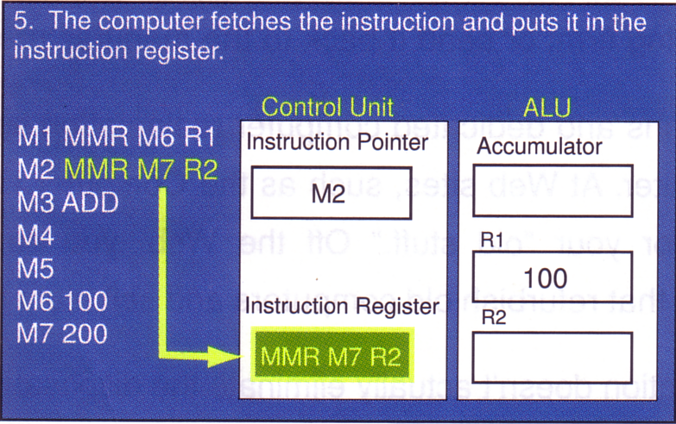

Slide 33
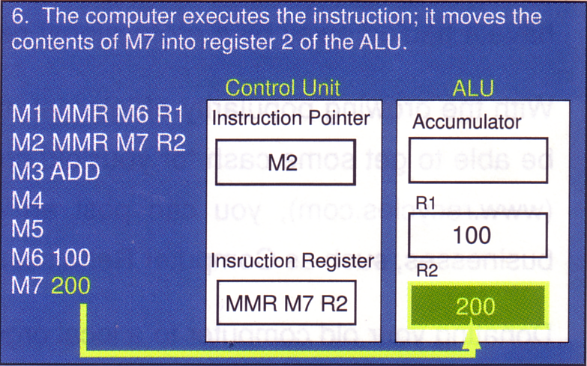

Slide 35
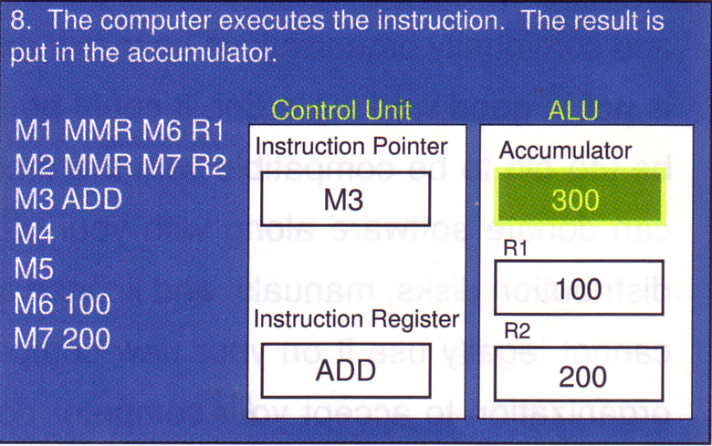

Slide 36
Make Sure You Have Enough Ram or It Can Be Upgraded!

