Slide 1
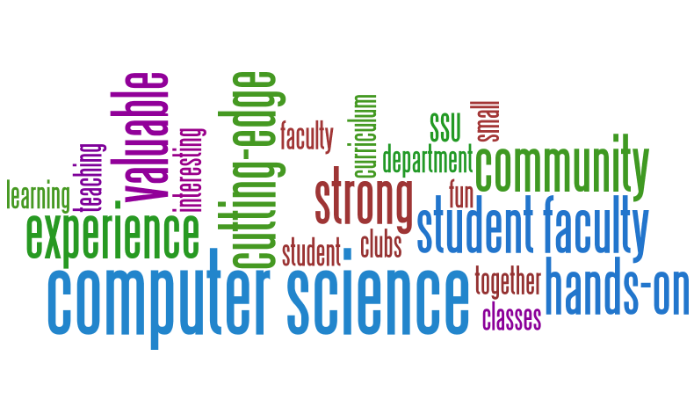
Computer Science Department
Sonoma State University

Slide 2
What type of person becomes a Computer Scientist?
People who are:
Creative
Problem solvers
Curious

Slide 3
What do Computer Science student’s study at Sonoma State University ?

Slide 4
How about a minor in CS?
Are there computers in your chosen field?
Would you like to learn to code?
Would knowing how to program give you an advantage in the job market over applicants who do not?
Would it be useful once working in your chosen field to be able to create your own programs?

Slide 5
What types of opportunities do Computer Science majors have upon graduation?

Slide 6
Computer science graduates are in greater demand than ever and can expect prosperous job and graduate school opportunities.

Slide 7
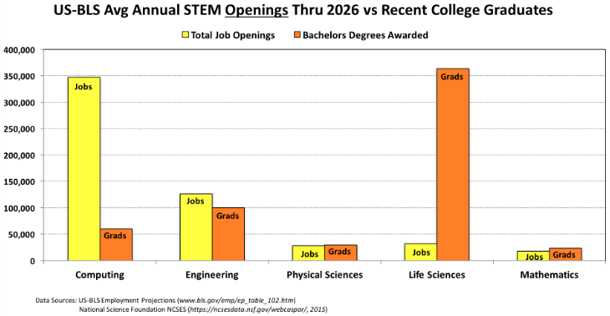
Total Yearly STEM Graduates
with Bachelor’s Degrees
Compared to Yearly STEM Job Openings

Slide 8
Average Salaries for Computer Occupations
U. S. Bureau of Labor
https://www.bls.gov/ooh/computer-and-information-technology/home.htm

Slide 9
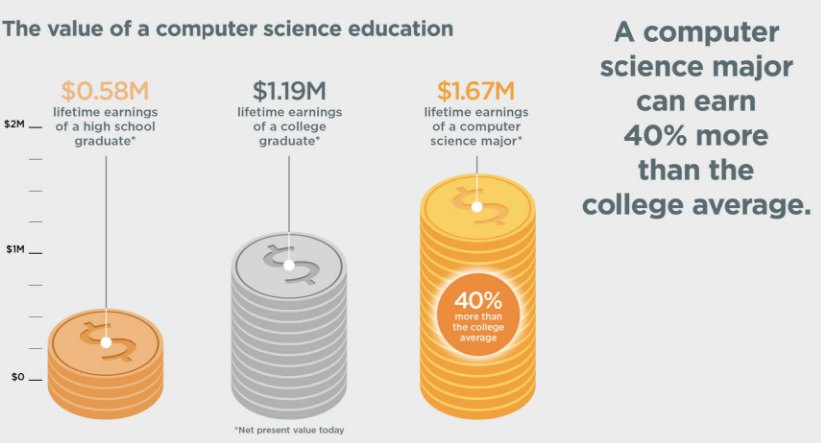
A Computer Science Degree Has Value
Source Data

Slide 10
U. S. News & World Report The 100 Best Jobs 2022
https://money.usnews.com/careers/best-jobs/rankings/the-100-best-jobs
https://money.usnews.com/money/careers/articles/how-us-news-ranks-the-best-jobs

Slide 11
Sound interesting?
Come By The Computer Science Department In Darwin 116
Or Call (707/664-2667)
Or Make An Advising Appointment Using The Links Below:
www.cs.sonoma.edu/advising/
Also Visit
www.cs.sonoma.edu
And Consider Taking
CS115: (Introduction to) Programming 1
Or going to a CS Club Meeting

